Slide 1
Weight training & Conditioning I
Basic Anatomy

Slide 2
Skeletal System
System made up of 206 bones and the attached connective tissue.
Functions: * Providing support for the body * Protecting internal tissues & organs * Acting as a framework for attached muscles * Allowing movement of limbs and digits * Producing new red & white blood cells * Storing fat & minerals

Slide 3
Skeletal System Activity
HANDOUT
To the best of your ability try to identify the names of the bones in the diagram. Do this on your own. You will then be given a chance to compare with a classmate. Finally, we will go over the correct identification of the bones as a class.

Slide 4
Skeletal System

Slide 5
Skeletal System Word Bank

Slide 6
Skeletal System Answer Key

Slide 7
Joints of the Body
There are 3 types of joints in the human body that we will focus on in Weight Training & Conditioning. These joints are: pivot, hinge, & ball-and-socket joints.

Slide 8
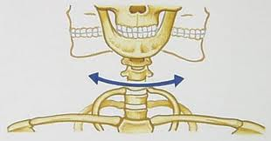
Pivot Joint
A joint in which a bone rotates around another; a joint permitting only rotating movement.
Example of a pivot joint: Head

Slide 9
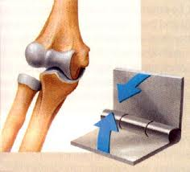
Hinge Joint
This is the simplest type of joint in the body. It allows for only movement in one direction.
Examples of a hinge joint: Elbows & Knees.

Slide 10
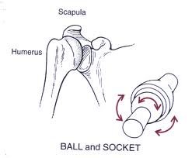
Ball-and-Socket Joint
This joint allows for the most range of motion. It is formed when the rounded end of one bone fits into the cavity or socket of another bone.
Examples of a ball-and-socket joint: Hips & Shoulders

Slide 11
Muscular System
System made up of approximately 639 muscles.
There are 3 basic types of muscles: * Skeletal * Smooth * Cardiac
Functions: * Regulates body temperature * Gives body shape * Allows for movement to occur

Slide 12
Skeletal Muscles
Muscles attached to bone that cause body movements. Appear striated, or striped, when viewed under a microscope. Most of your muscle tissue is skeletal, and almost all skeletal muscles are under voluntary control.

Slide 13
Smooth Muscles
Muscles that act on the lining of the body’s passageways and hollow internal organs. These can be found in digestive tract, urinary bladder, the lining of blood vessels, and passageways that lead to the lungs. These are involuntary muscles.

Slide 14
Cardiac Muscles
Type of striated muscle that forms the wall of the heart. Cardiac muscle is involuntary and is responsible for the contraction of your heart. The heart contracts rhythmically about 100,000 times each day to pump blood throughout your body.

Slide 15
Muscular System Activity
HANDOUT

Slide 16
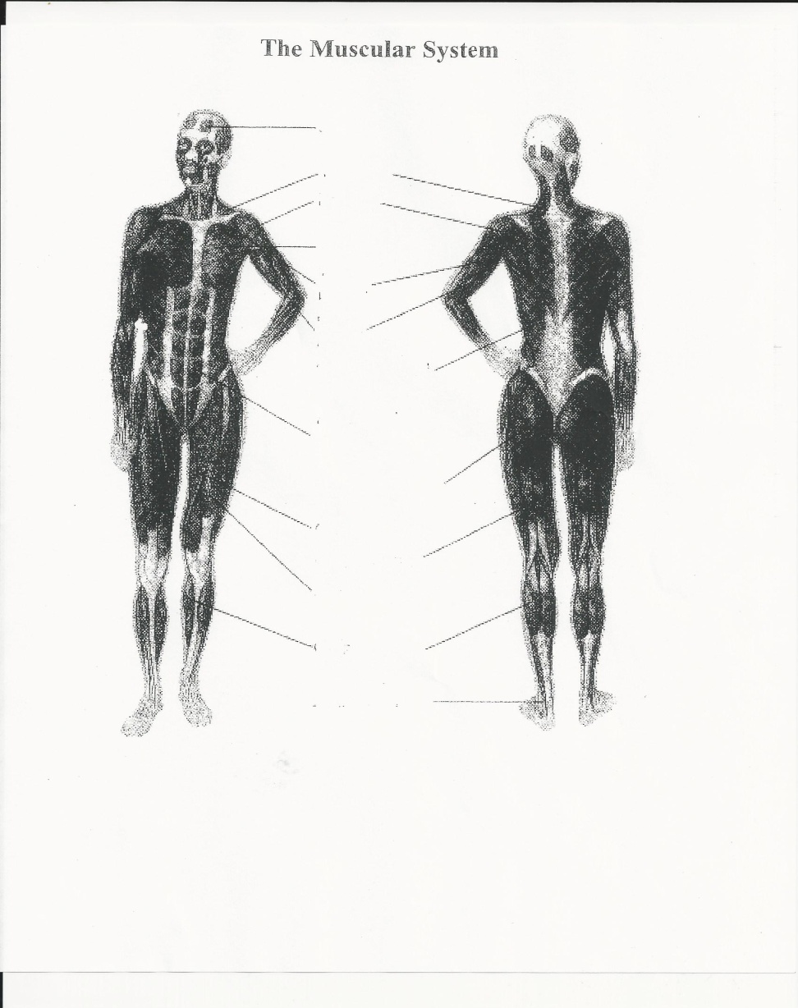
Muscular System Diagram

Slide 17
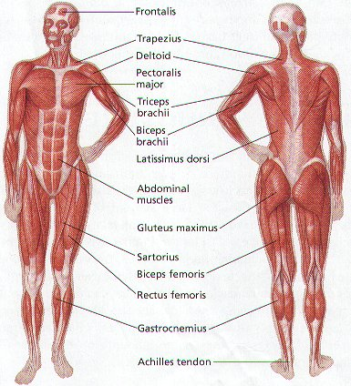
Muscular System Diagram Answer Key

