Slide 1
Weight Training Safety
It only takes a split second one time to change someone’s life forever….

Slide 2
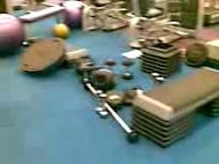
Always leave the weight room in better condition than you found it
Which would you rather use?

Slide 3
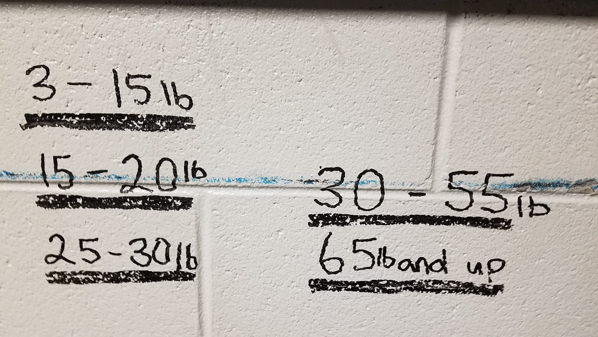
Return all equipment to its proper location

Slide 4
No horseplay or misuse of equipment at any time --will result in loss of points--
Playing soccer with med balls
Rolling weight plates across weight room
Squirting each other with water bottles
Throwing trash at each other
Making funny gestures behind someone while spotting
Inappropriate touching while lifting
Leg pressing on smith machine
Sitting/laying on equipment when not lifting

Slide 5
NO FOOD OR GUM IN WEIGHTROOM and PUT TRASH IN TRASHCAN!!

Slide 6
Wear appropriate shoes and clothing at all times
No open toed shoes or crocs are allowed
No cut-off shirts, tank tops, tube tops, or spaghetti strings
Sleeveless shirts are appropriate when not in the weight room
Shorts must be appropriate length
Shirts must be kept on when outside running and in the building

Slide 7
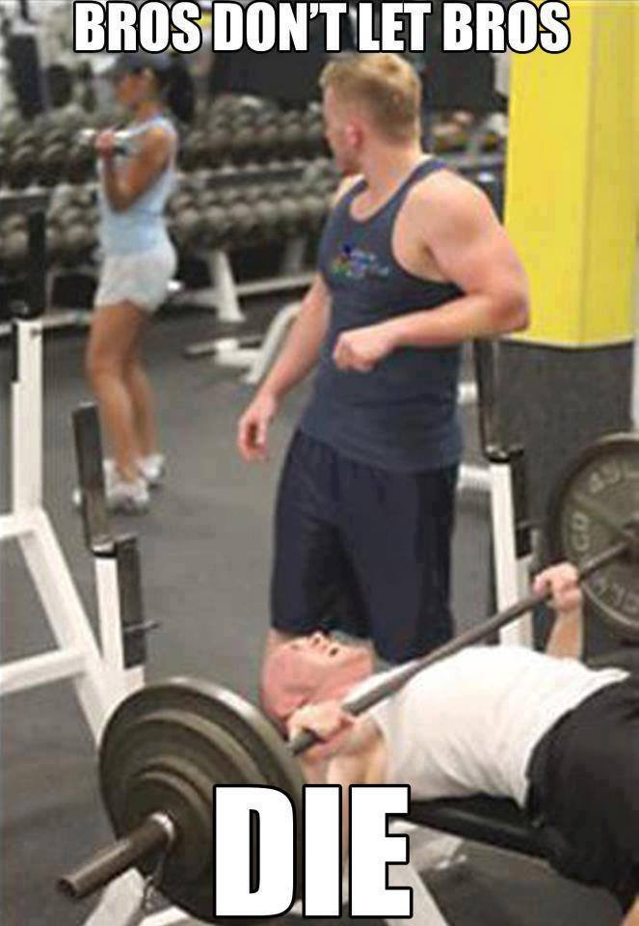
ALWAYS use a spotter when lifting free weights
Spotters must pay attention
Lifters make eye contact with spotter
Count down
Call “help” or “rack it”
Spotters don’t take hands off until weight
is still on the rack!
Do not hang or sit on the racks when
spotting for your partners

Slide 8
Do not slam or throw weights down on ground
BUMPER PLATES AND GREEN PLATES ARE ONLY WEIGHTS ALLOWED TO BE DROPPED ON THE FLOOR.
MEDICINE BALL THROWS ARE ACCEPTABLE BUT ONLY IF APPROVED BY THE COACH THAT DAY.
DO NOT THROW WEIGHT COLLARS OR OTHER EQUIPMENT

Slide 9
Do not lift without a supervisor in the room

Slide 10
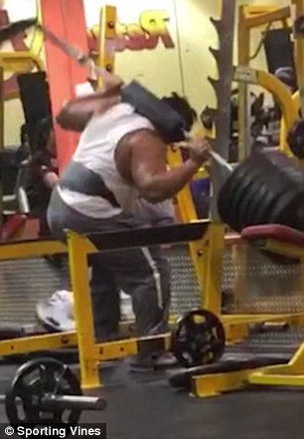
Always use collars when lifting free weights

Slide 11
Do not attempt a 1 Rep Max without permission from your coach

Slide 12
REPORT ANY INJURIES TO THE COACH IMMEDIATELY

